Slide 1
Notes:
Opening slide – Typically up for introductions and to give an opportunity to talk about how RFH belongs to every Rotarian in the room and that they are part of our success.

Slide 2
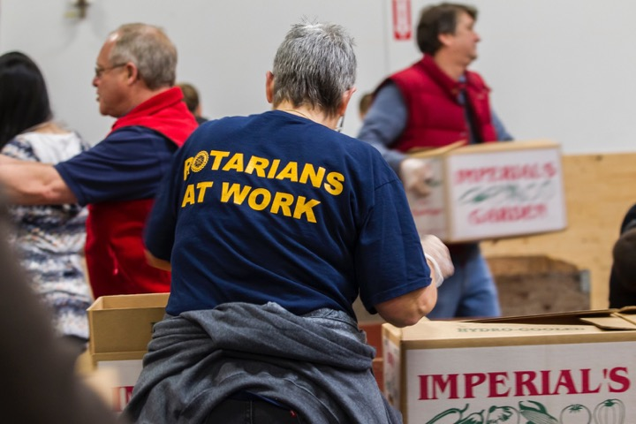

Slide 3
